Slide 1
ATC Cabinet Technical
PRESENTED BY
Team McCain
Copyright © 2014 McCain, Inc. All Rights Reserved.

Slide 2
ATC Cabinet Selection Matrix (L:\Product_Information\Product_Reference\Cabinets\ATC Cabinets)
Copyright © 2014 McCain, Inc. All Rights Reserved.
Notes:
Briefly cover what will be discussed during presentation

Slide 3
ATC Cabinet Selection Matrix (L:\Product_Information\Product_Reference\Cabinets\ATC Cabinets)
Copyright © 2014 McCain, Inc. All Rights Reserved.
Notes:
Briefly cover what will be discussed during presentation

Slide 4
ATC Cabinet Selection Matrix (L:\Product_Information\Product_Reference\Cabinets\ATC Cabinets)
ATC Cabinet-HV Revision 3 (9/23/2019)
CABINET | P/N | AGENCY | DESCRIPTION
358i Backpack | M53381-SC |  | 358i ATCC-HV,BACK PACK,IA-OA COMBO,(2)FITA-8CH,(2)FOTA-4CH,SA-HV, POWDERCOATED
 | M53391 |  | 358i ATCC-HV,BACK PACK,STRETCH,IA-OA COMBO,(2)FITA-8CH,(2)FOTA-4CH,SA-HV, NATURAL
 | M53381 |  | 358i ATCC-HV,BACK PACK,IA-OA COMBO,(2)FITA-8CH,(2)FOTA-4CH,SA-HV, NATURAL.
 | M53391-SC |  | 358i ATCC-HV,BACK PACK, STRETCH,IA-OA COMBO,(2)FITA-8CH,(2)FOTA-4CH,SA-HV, POWDERCOATED
 | M73476-SC | FORT WORTH | 358i ATCC-HV,BACK PACK,STRETCH,FORT WORTH, IA-OA COMBO, (2)FITA-8CH, (2)FOTA-4CH, SA-HV, P COATED.
 | M73476 | FORT WORTH | 358i ATCC-HV,BACK PACK,STRETCH,FORT WORTH, IA-OA COMBO, (2)FITA-8CH, (2)FOTA-4CH, SA-HV, NATURAL..
 | M78034 | ALBANY | 358i ATCC-HV,BACK PACK,STRETCH,ALBANY,IA-OA COMBO,(2)FITA-8CH,(2)FOTA-4CH,SA-HV,P COATED BLACK.
357i | M57213 |  | 357i ATCC-HV,STANDARD(MESA), NATURAL..
 | M36321 | LA CITY | 357i ATCC-HV, LA CITY, P/C, LOADED
 | M56811 | LA CITY | 357i ATCC-HV,LA CITY, POWDER COATED SILVER ANTI/GRAFFITI
 | M78107 |  | 357i ATCC-HV,STANDARD,ANODIZED.
356i | M54705 |  | 356i ATCC-HV,IA-24CH,OA-16CH,FOTA-16CH,SA,NATURAL
 | M55517 |  | 356i ATCC-HV,IA-24CH,FITA-24CH,OA-16CH,FOTA-16CH,SA,NATURAL
 | M55517-SC |  | 356i ATCC-HV,IA-24CH,FITA-24CH,OA-16CH,FOTA-16CH,SA,P/COATR COATED
 | M59758 | LA CITY | 356i ATCC-HV, LA CITY, OA-16CH W/O STOP TIME SW, IA-24CH, FITA-24CH V, FOTA-16CH, DC BUS, SA-HV
 | M73515-SC | ALBANY | 356i ATCC-HV ALBANY,OA-16CH-HV,FOTA-16CH, IA-24CH,FITA-24CH,SA-HV,P/COAT PER S.O.
 | M76382 | FORT WORTH | 356i ATCC-HV,FORT WORTH, IA-24CH, FITA-24CH V, OA-16CH, FOTA-16CH, SA-ONE FLASHER, NATURAL.
 | M78051 | ALBANY | 356i ATCC-HV,ALBANY,IA24CH,FITA24CH,OA16CH-HV,FOTA16CH,SA-HV,TEST,ALM,RJ45,P COATED BLACK.
 | M78079 |  | 356i ATCC-HV,IA-24CH,FITA-24CH,OA-16CH,FOTA-16CH,SA,ANODIZED.
 | M78142 | PHILADELPHIA | 356i ATCC-HV,PHILADELPHIA,IA-24CH,FITA-24CH,OA-16CH,FOTA-16CH,HEX HANDLE,P/COAT.
 | M36205 |  | ATC KIT, RACK ASSY,356i ON CASTERS
351 | M73841 | LA CITY | 351i ATCC-HV LA CITY, OA32CH-HV, IA48CH(1), FITA24CH(1), FOTA-16CH(2), SA-(2) FLASHER, ANTIGR
Copyright © 2014 McCain, Inc. All Rights Reserved.
Notes:
Briefly cover what will be discussed during presentation

Slide 5
ATC Cabinet Selection Matrix (L:\Product_Information\Product_Reference\Cabinets\ATC Cabinets)
352i | M54123 |  | 352i, ATCC-HV, IA-24CH,OA-16CH,FOTA-16CH,SA, NATURAL
 | M54123-SC |  | 352i, ATCC-HV, IA-24CH,OA-16CH,FOTA-16CH,SA, POWDER COATED
 | M55409 |  | 352i, ATCC-HV, IA-24CH,OA-32CH,(2)FOTA-16CH,SA NATURAL
 | M55515 |  | 352i, ATCC-HV,IA-24CH,FITA-24CH,OA-16CH,FOTA-16CH,SA, NATURAL
 | M55515A |  | 352i, ATCC-HV,IA-24CH,FITA-24CH,OA-16CH,FOTA-16CH,SA, ANODIZED
 | M55515-SC |  | 352i, ATCC-HV,IA-24CH,FITA-24CH,OA-16CH,FOTA-16CH,SA, POWDER COATED
 | M57911 |  | 352i, ATCC-HV, IA-24CH, FITA-24CH, OA-32CH,(2)FOTA-16CH, SA-TWO FLASHER, NATURAL
 | M57911A |  | 352i, ATCC-HV, IA-24CH, FITA-24CH, OA-32CH,(2)FOTA-16CH, SA-TWO FLASHER, ANODIZED
 | M56155 | FORT WORTH | 352i, ATCC-HV, FORT WORTH, IA-24CH,FITA-24CH,OA-16CH,FOTA-16CH,SA, NATURAL
 | M57909 | VIRGINIA | 352i, ATCC-HV,VDOT, IA-24CH, FITA-24CH, OA-16CH, FOTA-16CH, SA, ANTI GRAF
 | M57910 | VIRGINIA | 352i, ATCC-HV,VDOT, IA-24CH, FITA-24CH, OA-32CH,(2)FOTA-16CH, SA-TWO FLASHER, ANTI GRAF.
 | M58628-CT | SAN FRANCISCO | 352i, ATCC-HV,SF, FOREST P-COAT/ANTI-G (GREEN-OUT/ WHITE-IN).
 | M59725 | LA CITY | 352i, ATCC-HV LA CITY, OA32CH-HV, IA48CH, FITA24CH(2), FOTA-16CH(2), SA-(2) FLASHER, ANTIGR..
 | M73492 |  | 352i, ATCC-HV,(2)IA-24CH,(2)FITA-24CH,OA-16CH,FOTA-16CH,SA, NATURAL
 | M73472-SC |  | 352i, ATCC-HV, IA-24CH, FITA-24CH, OA-32CH, FOTA-32CH, SA-TWO FLASHER, POWDER COATED
 | M73506-SC | BRIDGEPORT | 352i ATCC-HV,BRIDGEPORT,OA-16CH-HV,IA-24CH,FITA-24CH,FOTA-16CH,SA, POWDER COATED
 | M73842 | MESA | 352i ATCC-HV,MESA,IA-24CH,FITA-24CH,OA-16CH,FOTA-16CH,SA-HV,ALARM PNL,NATURAL.
 | M73958 |  | 352i ATCC-HV,IA-48CH(2),FITA-48CH(2),OA-16CH,FOTA-16CH,SA, NATURAL
 | M73966 | MESA | 352i ATCC-HV,MESA,IA-48CH,FITA-48CH,OA-16CH,FOTA-16CH,SA-HV,ALARM PNL,NATURAL.
 | M74230-SC | ALBANY | 352i ATCC-HV ALBANY,OA-16CH-HV,FOTA-16CH, IA-24CH,FITA-24CH,SA-HV,P/COAT PER S.O.
 | M74238A |  | 352i, ATCC-HV,(2)IA-24CH,(1) FITA-48CH,OA HV-16CH,FOTA-16CH,SA-HV, ANODIZED.
 | M74239-SAG |  | 352i, ATCC-HV,(2)IA-24CH,(1) FITA-48CH,OA HV-16CH,FOTA-16CH,SA-HV, P/C SILVER/ANTI GRAFF.
 | M76075 | CALIFORNIA | 352i ATCC-HV,CALIFORNIA,(2)IA-24CH,FITA-48CH,OA-16CH,FOTA-16CH,SA, ANODIZED
 | M76076-SC | CALIFORNIA | 352i ATCC-HV,CALIFORNIA,(2)IA-24CH,FITA-48CH,OA-16CH,FOTA-16CH,SA, P-COAT.
 | M76076 | CALIFORNIA | 352i ATCC-HV,CALIFORNIA,(2)IA-24CH,FITA-48CH,OA-16CH,FOTA-16CH,SA, P-COAT, FS595C-17178.
 | M76386 | PASADENA | 352i ATCC-HV PASADENA,(2)IA-24CH,(2)FITA-24CH V,OA-16CH,FOTA-16CH,SA-HV, NATURAL.
 | M76488 | MONTREAL | 352i, ATCC-HV, MONTREAL, IA-24CH, FITA-24CH, OA-32CH, FOTA-32CH, SA-TWO FLASHER, P-COATED, PER S.O
 | M76599-SC | VIRGINIA | 352i,ATCC-HV,VDOT,(2)IA-24CH,(2)FITA-24CH,OA-16CH,FOTA-16CH,SA-ONE FLASHER, ANTI-G/P-COAT.
 | M76604 | ALBANY | 352i ATCC-HV ALBANY,OA-16CH-HV,FOTA-16CH, IA-24CH,FITA-24CH,SA-HV,NATURAL.
 | M76612 | HW-MNDOT | 352i, ATCC-HV,MNDOT,IA-24CH/W IDC26, FITA-24CH,OA HV-16CH,FOTA-16CH,SA-HV, ANODIZED.
 | M76620-SC | VIRGINIA | 352i,ATCC-HV,VDOT STD,(2)IA-24CH,(2)FITA-24CH,OA-16CH,FOTA-16CH,SA,NOT BOX, ANTI-G/P-COAT.
 | M76829-SC | VIRGINIA | 352i,ATCC-HV,VDOT OA-16CH, COMBO CAB, NO BOX, P-COAT WHT INSIDE, GRY ANTI-G OUTSIDE.
 | M76831-SC | VIRGINIA | 352i,ATCC-HV,VDOT OA-16CH, COMBO CAB W/BOX, P-COAT WHT INSIDE, GRY ANTI-G OUTSIDE.
 | M78020 | VIRGINIA | 352i,ATCC-HV,VDOT,OA-16CH,COMBO CAB W/BOX & GEN,P-COAT WHT IN,GRY ANTI-G OUT.
 | M78050 | ALBANY | 352i, ATCC-HV,ALBANY,IA24CH,FITA24CH,OA16CH-HV,FOTA16CH,SA-HV,TEST,ALM,RJ45,P COATED BLACK.
 | M78071 | VIRGINIA | 352i,ATCC-HV,VDOT,OA-32CH,COMBO CAB W/BOX & GEN,P-COAT WHT IN,GRY ANTI-G OUT.
 | M78075 | VIRGINIA | 352i,ATCC-HV,VDOT,OA-32CH,COMBO CAB & GEN INLET,NOT BOX,P-COAT WHT IN,GRY ANTI-G OUT
 | M78076 | VIRGINIA | 352i,ATCC-HV,VDOT,OA-16CH,COMBO CAB & GEN INLET,NOT BOX,P-COAT WHT IN,GRY ANTI-G OUT.
 | M78093 | VIRGINIA | 352i,ATCC-HV,VDOT STD,OA16CH WITH GEN INLET & BOX,P-COAT WHT IN,GRY ANTI-G OUT.
 | M78094 | VIRGINIA | 352i,ATCC-HV,VDOT STD,OA16CH WITH GEN INLET,NOT BOX,P-COAT WHT IN,GRY ANTI-G OUT.
 | M78095 | VIRGINIA | 352i,ATCC-HV,VDOT STD,OA32CH WITH GEN INLET & BOX,P-COAT WHT IN,GRY ANTI-G OUT.
 | M78097 | VIRGINIA | 352i,ATCC-HV,VDOT STD,OA32CH WITH GEN INLET,NOT BOX,P-COAT WHT IN,GRY ANTI-G OUT.
 | M78190 | MINESSOTA | 352i ATCC-HV,MNDOT,IA-24CH,FITA-24CH,OA-16CH,FOTA-16CH,SA,ANODIZED.
 | M36654 | SAN MARCOS | 352i ATCC-HV,SAN MARCOS,(2)IA24CH,IA48CH,(2)FITA24CH,FITA48CH,OA16CH,FRNT/FOTA-16CH,SA,ANODIZED.
 | M59276 |  | ATC KIT, RACK ASSY,352i,OA-32CH, ON CASTERS
Copyright © 2014 McCain, Inc. All Rights Reserved.
Notes:
Briefly cover what will be discussed during presentation

Slide 6
ATC Cabinet Selection Matrix (L:\Product_Information\Product_Reference\Cabinets\ATC Cabinets)
353i | M78144 | PHILADELPHIA | 353i ATCC-HV,PHILADELPHIA,IA-24CH,FITA-24CH,OA-16CH,FOTA-16CH,SA-HV,HEX HANDLE,P/COAT.
 | M78508 | WYLIE | 353i ATCC-HV,WYLIE,IA24CH,FITA24CH,OA16CH-HV,FOTA-16CH,SA,NATURAL OUTSIDE, WHITE INSIDE.
350i | M56764 |  | 350i,ATCC-HV,IA-24CH,FITA-24CH,OA-32CH,FOTA-16CH X 2,SA TWO FLASHERS,NATURAL
 | M73485 | LEESBURG | 350i ATCC-HV,LEESBURG,IA-24CH`,(2)IA-48CH, (5)FITA-24CH,OA-16CH-HV, FOTA-16CH,SA-HV, W/ CUTOUT, NAT
 | M73473 |  | 350i ATCC-HV,IA-24CH,OA-16CH-HV, FOTA-16CH,SA-HV ONE FLASHER, WITH CUTOUT, NATURAL
 | M74231 |  | 350i ATCC-HV,IA-24CH,OA-16CH-HV, FOTA-16CH,SA-HV ONE FLASHER, WITH CUTOUT, ANODIZED.
 | M59267 | FORT WORTH | 350i ATCC-HV,FORT WORTH,(2)IA-24CH,(2)FITA-24CH,OA-32CH,(2)FOTA-16CH,SA TWO FLASHERS,NATURAL
 | M76098 | CALIFORNIA | 350i ATCC-HV CALIFORNIA,(2)IA-24CH,FITA-48CH,OA-16CH,FOTA-16CH,SA, ANODIZED.
 | M76099 | CALIFORNIA | 350i ATCC-HV CALIFORNIA,(2)IA-24CH,FITA-48CH,OA-16CH,FOTA-16CH,SA, P-COAT PER S.O.
 | M76100 |  | 350i ATCC-HV,(2)IA-24CH,FITA-48CH,OA-16CH,FOTA-16CH,SA, P-COAT, FS595C-17178.
 | M76473-CT | SAN FRANCISCO | 350i ATCC-HV-SFO,(2)IA-24CH,OA-32CH,(2)FOTA-16CH,SA TWO FLASHERS,P-COAT.
 | M76840 | VIRGINIA | 350i ATCC-HV,VDOT,5-DOOR CONFIG,OA-16CH,P-COAT WHITE INSIDE,GRY ANTI-G OUTSIDE.
 | M78022 | VIRGINIA | 350i ATCC-HV,VDOT,5-DOOR CONFIG,OA-16CH,GEN INLET, P-COAT WTH IN,GRY ANTI-G OUT.
 | M78047 | ALBANY | 350i, ATCC-HV,ALBANY,IA24CH,FITA24CH,OA16CH-HV,FOTA16CH,SA-HV,TEST,ALM,RJ45,P COATED BLACK.
 | M78078 |  | 350i ATCC-HV,IA-24CH,OA-16CH-HV, FOTA-16CH SPRING,SA-HV,WITH CENTER CUT,NATURAL.
 | M78083 |  | 350i ATCC-HV,IA-24CH,OA-32CH-HV,(2)FOTA-16CH SPRING,SA-HV,WITH CENTER CUT,NATURAL.
 | M78131 |  | 350i ATCC-HV,IA-48CH,FITA-48CH,OA-32CH,(2)FOTA-16CH,SA TWO FLASHERS,NATURAL.
 | M78139 | VIRGINIA | 350i ATCC-HV,VDOT,5-DOOR CONFIG,OA-32CH,W GEN INLET, P-COAT WTH IN,GRY ANTI-G OUT.
 | M78428 | MINESSOTA | 350i ATCC-HV,MNDOT,OA-32CH-HV,(2)FOTA 16CH,(2)IA-24CH,(2)FITA-24CH,SA TWO HV,ANODIZED.
M-ATC | M73471 |  | M-ATCC-HV, OA-16CH, FOTA-16CH, IA-24CH, FITA-24CH, SA-ONE FLASHER-HV, NATURAL, X01
 | M73038-SC |  | M-ATCC-HV, OA-16CH, FOTA-16CH, IA-24CH, FITA-24CH, SA-ONE FLASHER-HV, POWDER COATED PER S.O
 | M59869 | SAN FRANCISCO | M61-ATCC-HV-SF, OA-16CH, FOTA-16CH, IA-24CH, FITA-24CH, SA-ONE FLASHER-HV,P/COATED
 | M76376-CT | SAN FRANCISCO | M65-ATCC-HV-SF,OA-16CH,FOTA-16CH,IA-24CH,FITA-24CH,SA-ONE FLAS-HV,P/COATED,CT.
 | M76453-CT | SAN FRANCISCO | M75-ATCC-HV-SF,OA-16CH,FOTA-16CH,IA-24CH,FITA-24CH,SA-ONE FLAS-HV,P/COATED,CT.
 | M78029-SC |  | M65-ATCC-HV,OA-16CH, FOTA-16CH, IA-24CH, FITA-24CH, SA-HV-H,P-COATED PER S.O.
 | M78055 |  | M65-ATCC-HV,OA-16CH, FOTA-16CH, IA-24CH, FITA-24CH, SA-HV-H,NATURAL.
P-ATC | M78158-SC |  | P-ATCC-HV, OA32CH-HV,FOTA32CH,IA-48CH,IA-24CH,FITA-48CH,FITA-24CH,SA-TWO-HV,P-COAT.
 | M78467 |  | P-ATCC-HV, OA16CH-HV,LOADBAY-16CH,IA-24CH,FITA-24CH,SA-ONE-HV,NATURAL.
 | M78500-SC |  | P-ATCC-HV, OA32CH-HV,FOTA32CH,IA-48CH,(2)FITA-24CH,SA-TWO-HV,P-COAT,PER S.O.
Copyright © 2014 McCain, Inc. All Rights Reserved.
Notes:
Briefly cover what will be discussed during presentation

Slide 7
ATC Cabinet Assembly Variations (V:\Electronics\Types of FITA-FOTA-SA)
Copyright © 2014 McCain, Inc. All Rights Reserved.
Notes:
Briefly cover what will be discussed during presentation

Slide 8
ATC Cabinet Assembly variations (V:\Electronics\Types of FITA-FOTA-SA)
Copyright © 2014 McCain, Inc. All Rights Reserved.
Notes:
Briefly cover what will be discussed during presentation

Slide 9
ATC Cabinet Assembly variations (V:\Electronics\Types of FITA-FOTA-SA)
Copyright © 2014 McCain, Inc. All Rights Reserved.
Notes:
Briefly cover what will be discussed during presentation

Slide 10
ATC Cabinet Assembly variations (V:\Electronics\Types of FITA-FOTA-SA)
Copyright © 2014 McCain, Inc. All Rights Reserved.
Notes:
Briefly cover what will be discussed during presentation

Slide 11
ATC Cabinet Assembly variations (V:\Electronics\Types of FITA-FOTA-SA)
Copyright © 2014 McCain, Inc. All Rights Reserved.
Notes:
Briefly cover what will be discussed during presentation

Slide 12
ATC Cabinet Assembly variations (V:\Electronics\Types of FITA-FOTA-SA)
Copyright © 2014 McCain, Inc. All Rights Reserved.
Notes:
Briefly cover what will be discussed during presentation

Slide 13
ATC Cabinet Assembly variations (V:\Electronics\Types of FITA-FOTA-SA)
Copyright © 2014 McCain, Inc. All Rights Reserved.
Notes:
Briefly cover what will be discussed during presentation

Slide 14
ATC Cabinet Assembly variations (V:\Electronics\Types of FITA-FOTA-SA)
Copyright © 2014 McCain, Inc. All Rights Reserved.
Notes:
Briefly cover what will be discussed during presentation

Slide 15
ATC Cabinet Assembly variations (V:\Electronics\Types of FITA-FOTA-SA)
Copyright © 2014 McCain, Inc. All Rights Reserved.
Notes:
Briefly cover what will be discussed during presentation

Slide 16
ATC Cabinet Assembly variations (V:\Electronics\Types of FITA-FOTA-SA)
Copyright © 2014 McCain, Inc. All Rights Reserved.
Notes:
Briefly cover what will be discussed during presentation

Slide 17
ATC Cabinet Assembly variations (V:\Electronics\Types of FITA-FOTA-SA)
Copyright © 2014 McCain, Inc. All Rights Reserved.
Notes:
Briefly cover what will be discussed during presentation

Slide 18
ATC Cabinet Assembly variations (V:\Electronics\Types of FITA-FOTA-SA)
Copyright © 2014 McCain, Inc. All Rights Reserved.
Notes:
Briefly cover what will be discussed during presentation

Slide 19
ATC Cabinet Assembly variations (V:\Electronics\Types of FITA-FOTA-SA)
Copyright © 2014 McCain, Inc. All Rights Reserved.
Notes:
Briefly cover what will be discussed during presentation

Slide 20
ATC Cabinet Assembly variations (V:\Electronics\Types of FITA-FOTA-SA)
Copyright © 2014 McCain, Inc. All Rights Reserved.
Notes:
Briefly cover what will be discussed during presentation

Slide 21
ATC Cabinet Assembly variations (V:\Electronics\Types of FITA-FOTA-SA)
Copyright © 2014 McCain, Inc. All Rights Reserved.
Notes:
Briefly cover what will be discussed during presentation

Slide 22
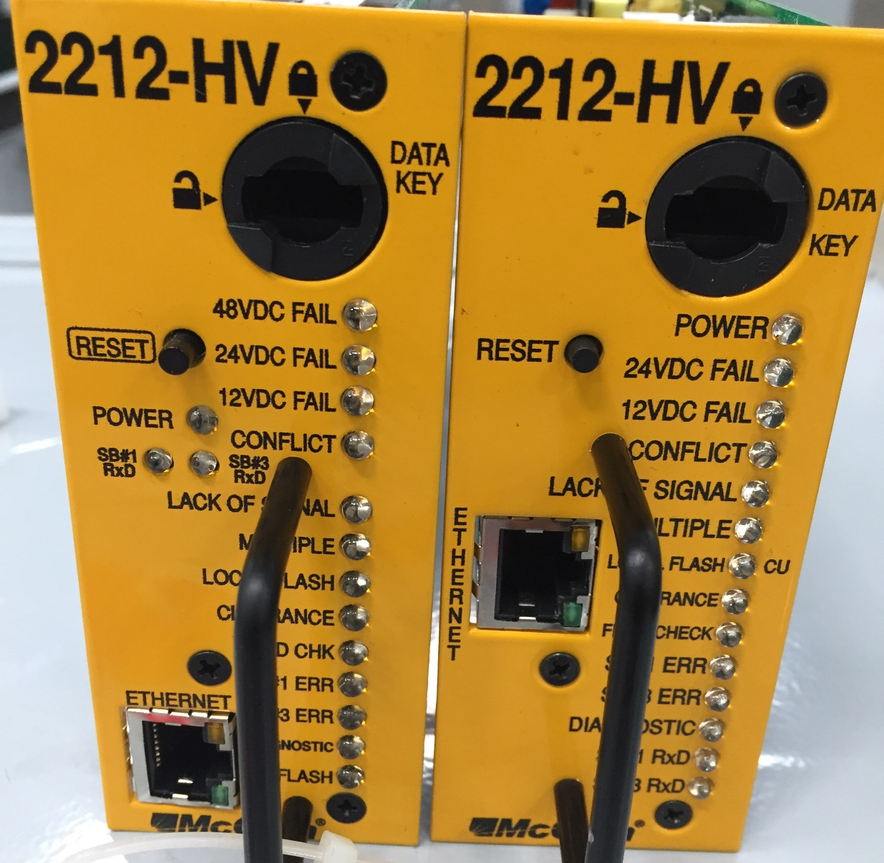
CMU 2212-HV vs. CMU 2212-HV

Slide 23
CMU 2212-HV Enhancement
The LED display on the front panel of the CMUip-2212 will add two additional indicators and move three other indicators.
The current indicator CU/LOCAL FLASH will be split into two separate indicators (CU and LOCAL FLASH) for better diagnostic reporting to the service technician.
A 48VDC FAIL indicator is being added to support the new 48VDC CPS monitor function.
To make room for these two new indicators, the POWER, SB#1 Rx and SB#3 Rx indicators are being physically moved to the Ethernet daughter board.
Copyright © 2014 McCain, Inc. All Rights Reserved.
Notes:
Briefly cover what will be discussed during presentation

Slide 24
CMU 2212-HV Datakey Programming
This addition of the 48VDC monitor function will create a backward compatibility issue for users already deploying your current version of the HV cabinet with a new CMU. This issue will be handled by a new programming option in the CMU Datakey and assumes that the CMU has firmware v0120 or better installed.

Slide 25
Cabinet System Comparison
170 cabinet or TS 1 cabinet system
Controller Unit
Detector
Switch Pack
TS 2 cabinet system
Controller Unit
Detector
BIU
BIU
Switch Pack
SDLC Bus
ATC Cabinet system
Controller Unit
Detector
SIU
SIU
HDSP
SB1 / SB2 Bus

Slide 26
ATC Cabinet Serial Bus System
Controller Unit
Input Assembly #1-5
SIU
Serial Bus 1 & 2
Output Assembly
Serial Bus 3
CMU
SIU
Auxiliary Display Unit
Service Assembly
HDFU

Slide 27
ATC Cabinet Serial Bus System
Serial Bus #1
Links controller to:
SIU input assembly
SIU output assembly
SIU performs the I/O function for the controller
CMU
Serial Bus #2
Links controller to:
Advanced devices in cabinet for non-control applications
Serial Bus #3
Links the CMU to:
HDSP/FU (in SA)
HDSP/FU (in OA)
Auxiliary Display Unit (ADU)

Slide 28
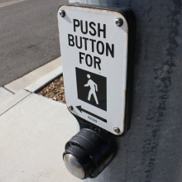
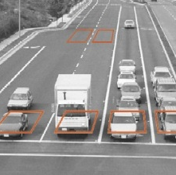
ATC Cabinet Block Diagram
Clean Power Bus Assembly
Controller Unit (CU)
SB1 / SB2 Assembly
Raw Power
Auxiliary Display Unit (ADU)
Clean Power
Cabinet Power Supply (CPS)
DC Power
SB1 / SB2
Input Assembly I-5 (IA)
Misc. Connection
DC Power Bus Assembly
Detector, PPB, etc.
Output Assembly (OA)
Field Input Termination Assembly (FITA)
Field Output Termination Assembly (FOTA)
Service Assembly (SA)
Utility Power
Copyright © 2014 McCain, Inc. All Rights Reserved.

